Slide 1

TOD: Task-Oriented Dialogue
July 20, 2023
Language & Intelligence Lab
Artificial Intelligence Graduate School
Yumin Kim
2023 U-SURF Research Intern

Slide 2

CONTENTS
1. TOD
03
2. <SimpleTOD> Review
13
3. Recent Advancements
19

Slide 3
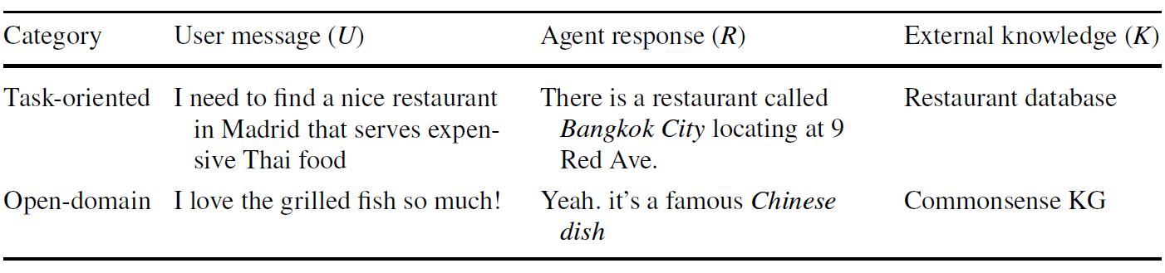
1. TOD
Conversational AI
Conversational AI
Open-domain dialogue system
ex) Chit-chat
Training: end-to-end
Data: large-scale data from social media
Task-Oriented dialogue system (TOD)
ex) hotel reservation, medical consultant chatbot
Goal: To accomplish a goal described by a user
Notes:
Open-domain dialogue:
Open-ended (No limit or boundary) conversations with human in more natural and attractive

Slide 4
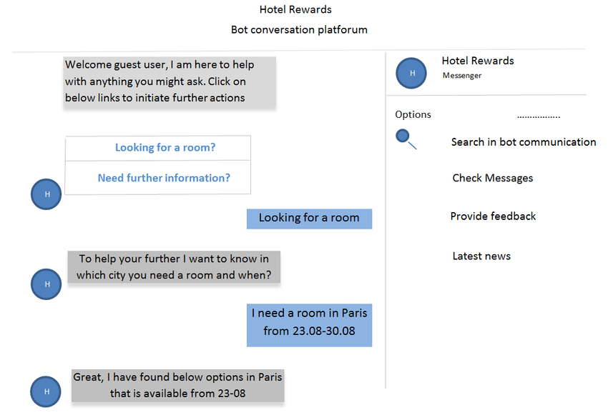
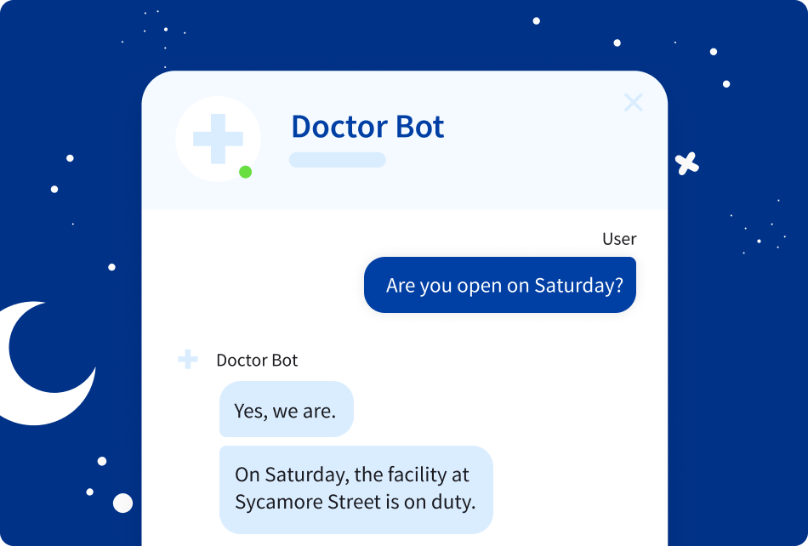
1. TOD
Example of TOD

Slide 5
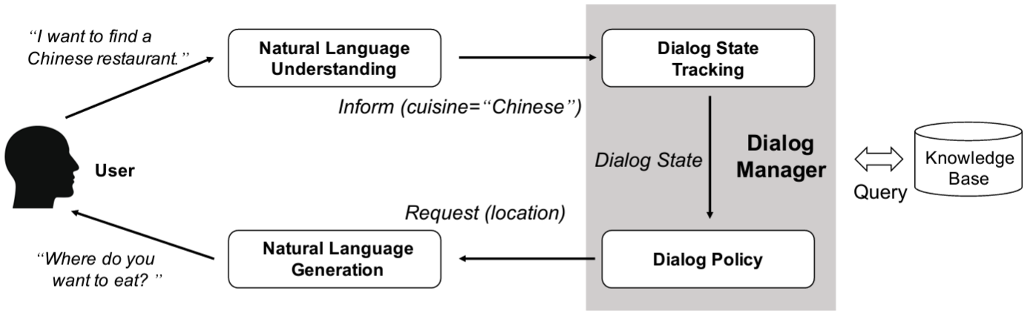
1. TOD
Traditional 3 Pipelines
NLU module: extract belief state
DM module (Dialogue Manager): decides which actions to take based on those beliefs
- Dialogue State Tracking (DST), Dialogue Policy
NLG module: generate responses
➔ Traditionally, each component is trained independently with different supervision
Notes:
<TOD 3가지 Sub-Tasks>
NLU: 사용자의 발화를 이해하기 위한 모듈.
입력으로 들어온 발화는 분석되어 정형화된 데이터로 변환됨.
DM (Dialogue Manager):
사용자와 시스템이 주고 받는 대화의 흐름을 관리합니다.
Dialog State Tracker 모듈: 현재 대화 상태를 추적 관리.
NLU 결과로부터 Dialog State 를 업데이트 하면서 대화를 진행.
실제로는 NLU 결과 뿐 아니라 더 많은 데이터를 유지.
Policy Manager 모듈: 내부 정책을 통해서 시스템이 사용자에게 전달할 Action 을 결정.
Action 은 NLG 에게 바로 전달되기도 하고 Database로부터 응답에 필요한 정보를 가져오는데 사용되기도 함.
3. NLG:
DM 으로부터 데이터를 입력 받아서 사람이 쉽게 이해할 수 있는 시스템의 응답을 생성.
응답은 각 시스템의 페르소나를 결정할 수 있기 때문에 매우 주의 깊게 다루어야 함.

Slide 6

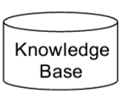

1. TOD
Traditional 3 Pipelines: Example
I’m looking for a restaurant at UNIST.
Dialogue state (=Belief state):
Domain(restaurant), Area(UNIST), Date(07-20-2023),
Intent(Search_Restaurant)
Database Query
SELECT *from RESTAURANT
WHERE area=UNIST
NLU + DST
Dialogue Manager
Decide Action:
INFORM_CHOICE, REQUEST_FOOD,
BYE, CONFIRM, ….
Policy
Query Result
value_count = 5
There are [value_count] restaurants that meet your
criteria. What type of food do you want?
NLG
Notes:
<TOD 3가지 Sub-Tasks>
NLU: 사용자의 발화를 이해하기 위한 모듈.
입력으로 들어온 발화는 분석되어 정형화된 데이터로 변환됨.
DM (Dialogue Manager):
사용자와 시스템이 주고 받는 대화의 흐름을 관리합니다.
Dialog State Tracker 모듈: 현재 대화 상태를 추적 관리.
NLU 결과로부터 Dialog State 를 업데이트 하면서 대화를 진행.
실제로는 NLU 결과 뿐 아니라 더 많은 데이터를 유지.
Policy Manager 모듈:
Action 은 NLG 에게 바로 전달되기도 하지만, Database로부터 응답에 필요한 정보를 가져오는데 사용되기도 함.
내부 정책을 통해서 시스템이 사용자에게 전달할 Action 을 결정.
3. NLG:
DM 으로부터 데이터를 입력 받아서 사람이 쉽게 이해할 수 있는 시스템의 응답을 생성.
응답은 각 시스템의 페르소나를 결정 ← 친절한 안내원.
Traditionally, 각 모듈마다 따로따로 각각 학습됨.
NLU module ← domain and intent labels
DM module ← belief state and action labels
NLG module ← natural responses

Slide 7
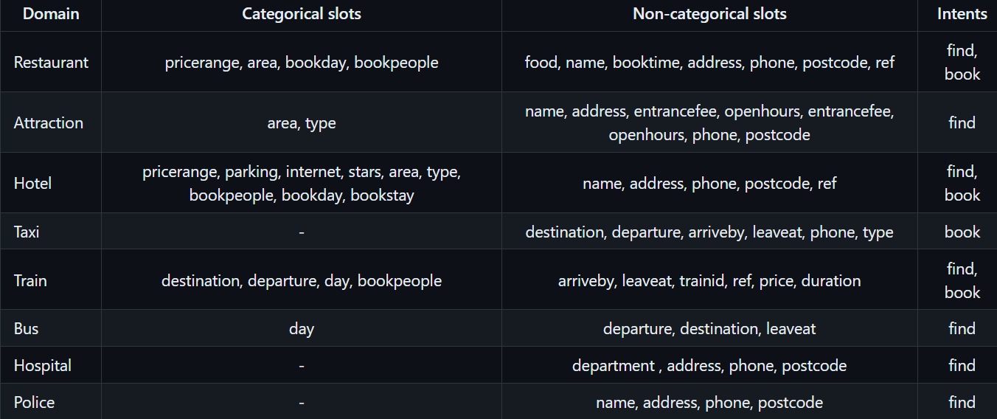
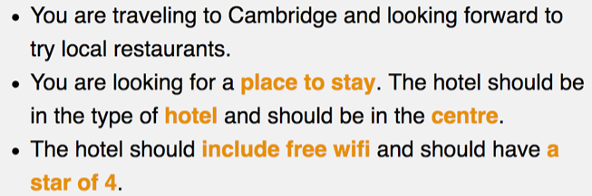
1. TOD
MultiWOZ Dialogue Dataset (Multi-Domain Wizard-of-Oz)
CamRest and MultiWOZ
8 domains
14,000 multi-turn dialogues
sample task template (domain: hotel)

Slide 8
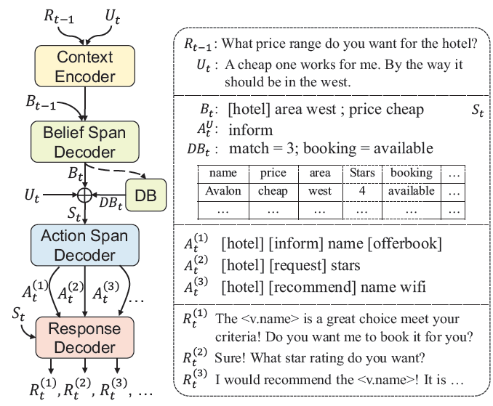
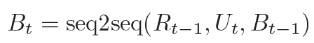
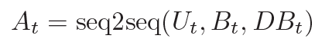
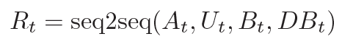
1. TOD
Towards End-to-End Training
Prior work (1) domain-aware multi-decoder model (DAMD) + augmentation
Single-sequence: Greedy Decoding
Multiple actions: Beam Search + Diverse Beam Search/Top-K Sampling
Notes:
DAMD used augmented dialogue datasets
Focus on context-to-response generation task proposed for MultiWOZ
The Belief State, system Action, Response are generated in seq2seq manner
<Modules>
Context Encoder
Belief Span Decoder ➔ St update (dialogue state)
Action Span Decoder
System Response Decoder
[v.name]: domain-aware delexicalization
First perform delexicalization to pre-process dialog utterances to reduce surface from language variability
Previous methods: delexicalize the same slots in different dialog domains → as different tokens
Ex) [restaurant.phone], [hotel.phone]
DAMD: represent same slot name in different dialog domains, just using one token
Ex) [v.phone] ➔ the expressions in all relevant domains can be used to learn to generate the delexicalized value token
<Decoding Process>
single-sequence → Greedy Decoding [heuristic]
각 타임 스텝에서, output sequence에서 생성된 각각의 확률분포에서 가장 probability 값이 높은 하나의 토큰 선택하는 디코딩 알고리즘
장점: 직관적, 간단, 빠른 속도
Multiple actions → leverage standard Beam Search algorithm + several diversity-promoted decoding schemes [heuristic]
Beam search: 각 타임 스텝에서 탐색의 영역을 k개의 가장 probability 높은 토큰들로 유지 (k = hyper-parameter; usually 5 or 10)
Diverse Beam search: adds a penalty term to intra-sibling sequences thus favors choosing hypotheses from diverse parents
Top-K sampling: samples the next word from the k most probable choices according to vocabulary distribution
Good for Story Generation, But 모델의 창의성 저하
Sampling: 디코딩에 랜덤성 추가 → Non-deterministic

Slide 9
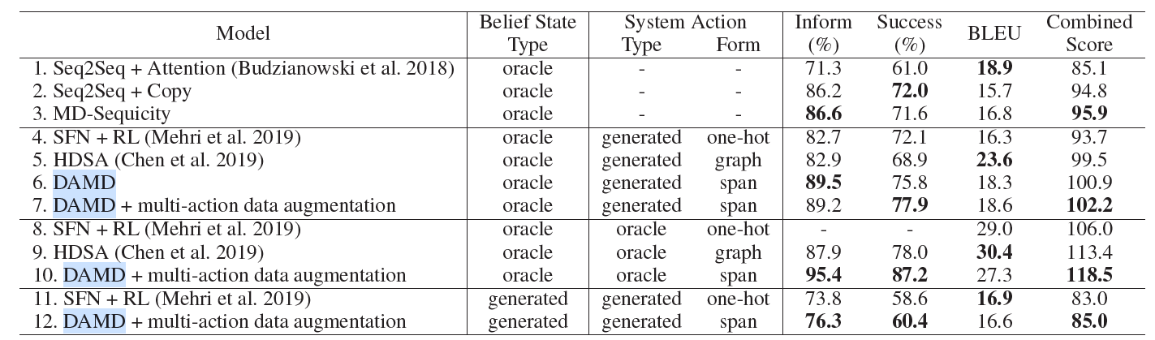
1. TOD
Towards End-to-End Training
Prior work (1) domain-aware multi-decoder model (DAMD) + augmentation
[Evaluation] SoTA combined score for Dialogue Management and Response Generation
<Automatic Evaluation Metrics>
Inform rate: provides an correct entity
Success rate: answers all the requested information
BLEU: fluency
Combined score: (inform + Success) x 0.5 + BLEU
= overall quality measure
Notes:
DAMD used augmented dialogue datasets
response generation 성능 비교표 (MultiWOZ 기준) [system action이 어떻게 모델링 되었는지에 따라 grouped]
And follow their (MultiWOZ) automatic evaluation metrics
Oracle: using ground truth
Generated: generated results
<NOTE>
MD-Sequicity
Simplified version of DAMD with the action span decoder removed
Original Sequicity model+ only extends the belief span to support multi-domain belief tracking
SFN
Seq2seq network comprised of several pre-trained dialog modules which are connected through hidden states
+) additionally, Reinforcement fine tuning is used to training
HDSA (Hierarchical Disentangled Self-Attention network)
BERT-based action predictor is used to predict system actions

Slide 10
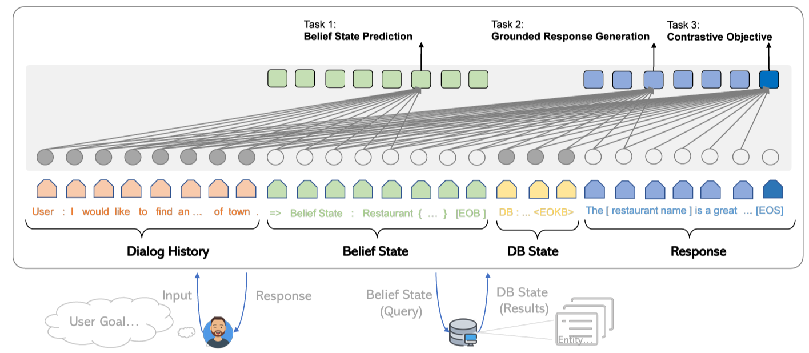
1. TOD
Towards End-to-End Training
Prior work (2) SOLOIST: GPT2-based end-to-end training model
Notes:
Use Transfer learning + Machine Teaching → to efficiently build 대규모의 TOD 시스템
Machine teaching: fine tuning 위한 labeling cost 줄임
Contrastive objective:
matched items (positive samples )를 촉진시키고 mismatched items (negative samples )을 억제하기 위해 사용된다. [user goal과 비교]
Negative samples는 50% 확률로 내 약간의 items을 dataset 로부터 랜덤하게 샘플링 된 다른 items으로 대체하여 생성된다.

Slide 11
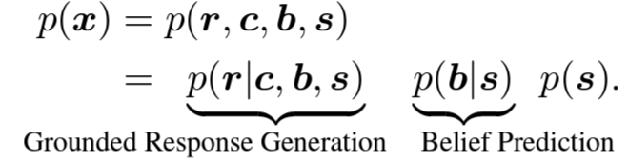
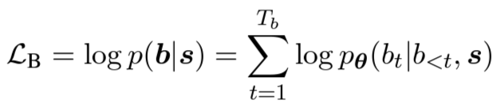
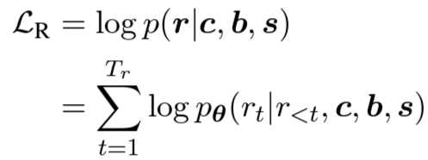
1. TOD
Towards End-to-End Training
Prior work (2) SOLOIST: GPT2-based end-to-end training model
Notes:
x: 각 항목은 그 자체로 sequence의 token이다. 따라서 모델 훈련 시 긴 sequence로써 해당 항목들을 결합하여 다룬다.
Contrastive objective:
matched items (positive samples )를 촉진시키고 mismatched items (negative samples )을 억제하기 위해 사용된다. [user goal과 비교]
Negative samples는 50% 확률로 내 약간의 items을 dataset 로부터 랜덤하게 샘플링 된 다른 items으로 대체하여 생성된다. (cross-entropy objective)
MLE (maximize log likelihood) Objective

Slide 12
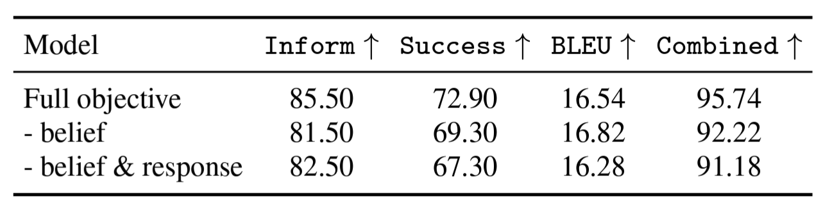
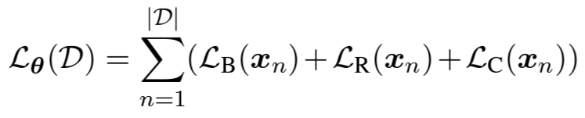
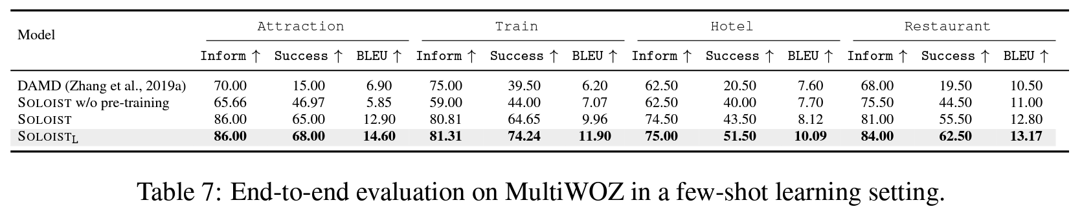
1. TOD
Towards End-to-End Training
Prior work (2) SOLOIST: GPT2-based end-to-end training model
[Evaluation] New SoTA,
But didn’t show end-to-end performance w/o pretraining on other dialogue datasets
Notes:
DAMD와의 Combined Score는 비교 결과 논문에서 찾지 못함.

Slide 13
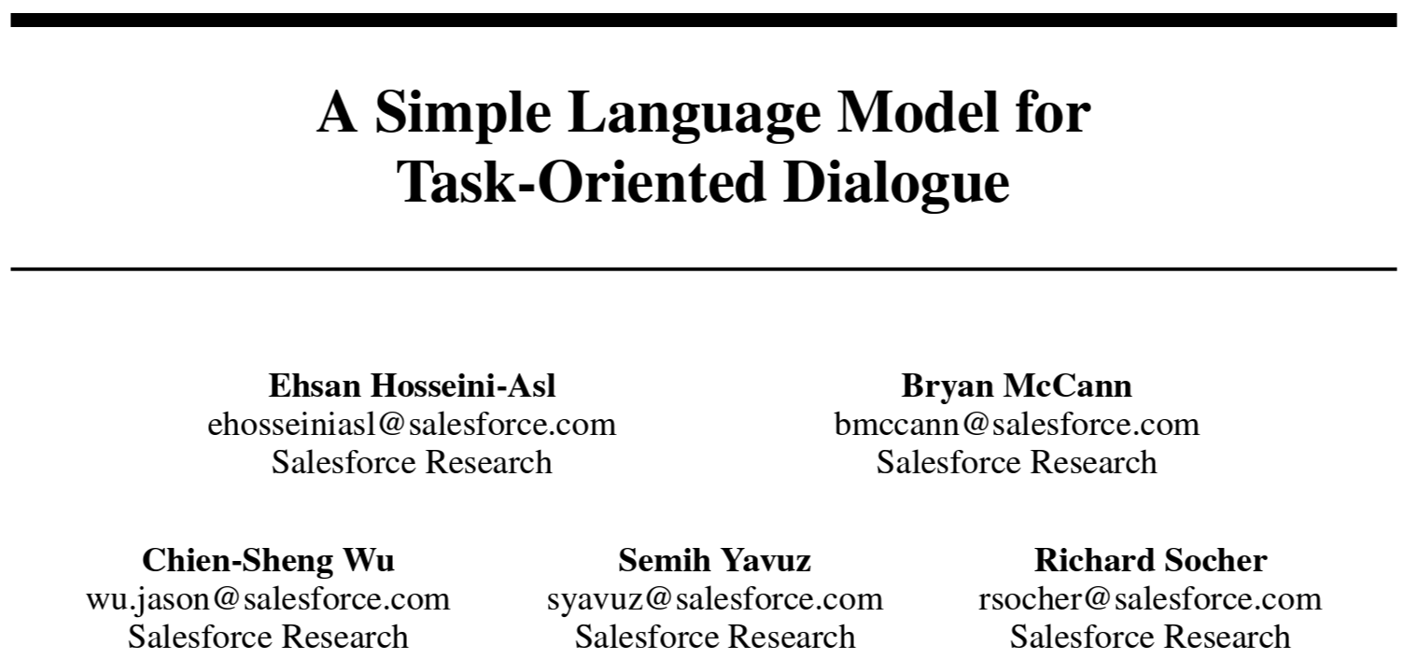
2. <SimpleTOD> Review
Overview
SimpleTOD:
End-to-End Baseline Model
uses a single, casual (unidirectional) LM
trained on all sub-tasks
in an end-to-end single sequence prediction
first model to achieve SoTA performance for
DST, action decisions, and response generation

Slide 14
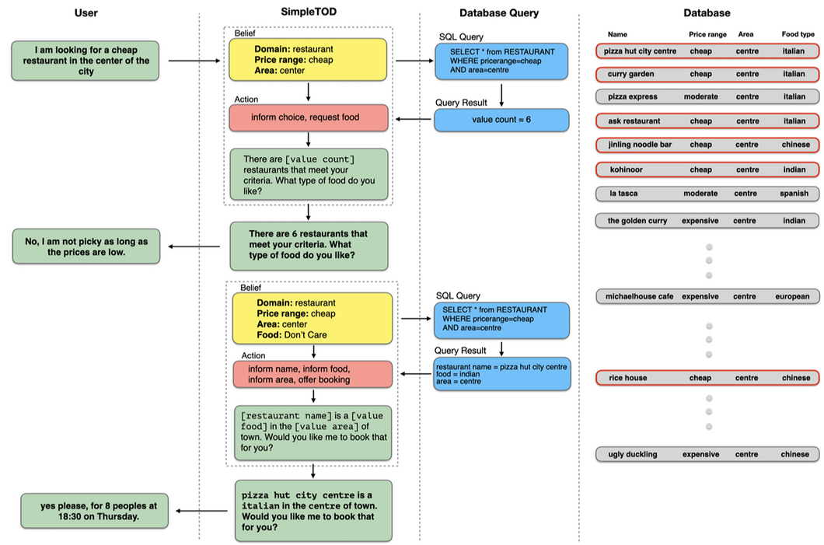

Slide 15
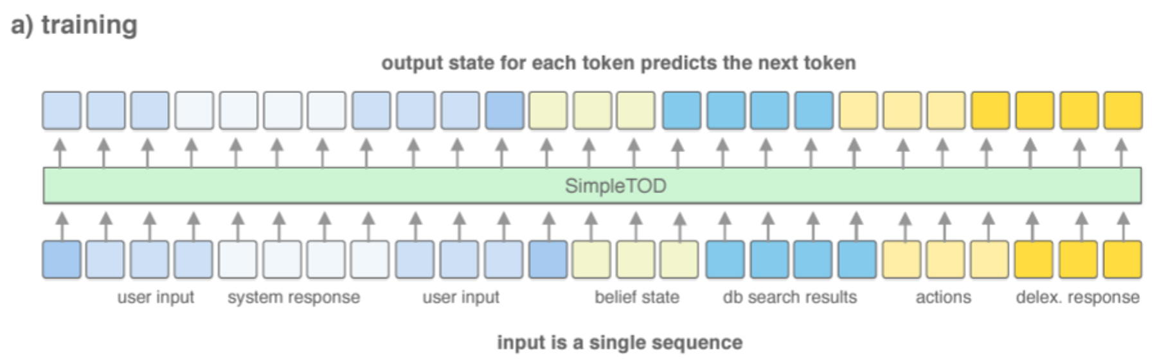
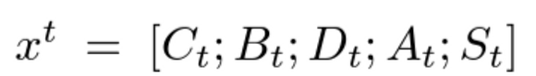
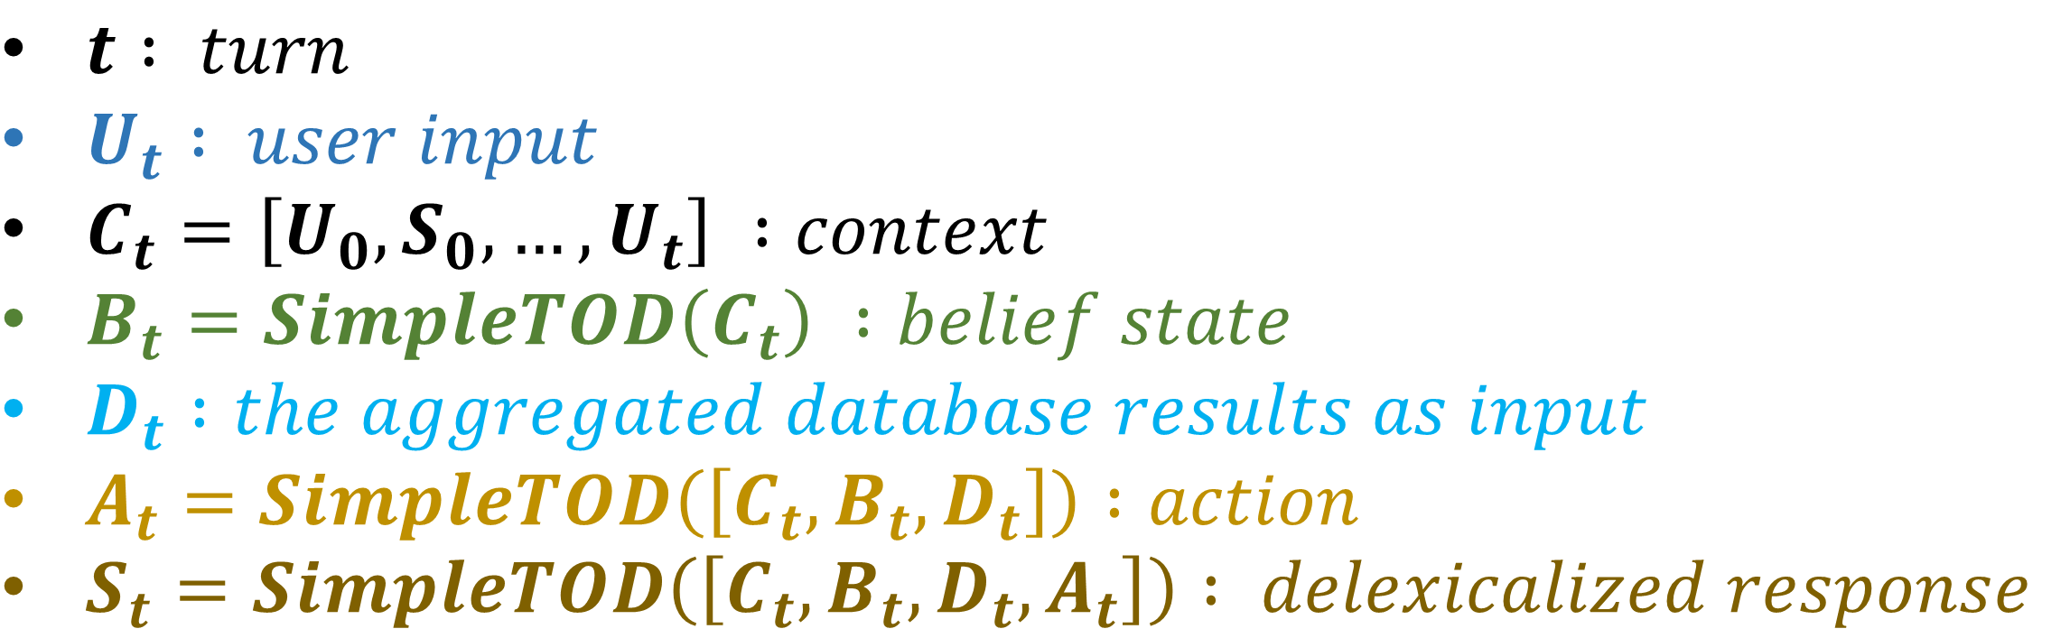
2. <SimpleTOD> Review
Training
$t : turn$
$U_{t} : user input$
$C_{t}=\left[U_{0},S_{0},…, U_{t}\right] :context$
$B_{t}=SimpleTOD\left(C_{t}\right) :belief state$
$D_{t} :the aggregated database results as input$
$A_{t}=SimpleTOD\left(\left[C_{t}, B_{t}, D_{t}\right]\right) :action$
$S_{t}=SimpleTOD\left(\left[C_{t}, B_{t}, D_{t}, A_{t}\right]\right) : delexicalized response$
Notes:
Dt: 반환된 rows의 수와 예약 상태 정보 여부를 포함한다. 즉, 검색 결과를 직접 사용하지 않고 얼마나 나왔는지 정도만 사용
At, St : 단일 sequence로서 결합된 C, B, D, A 조건화 하여 생성

Slide 16
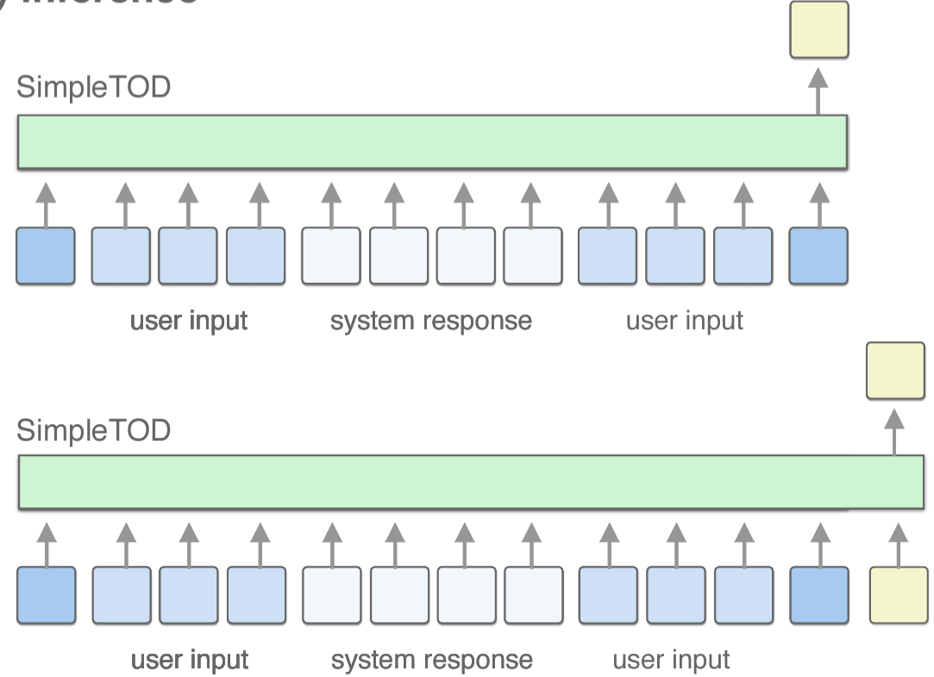
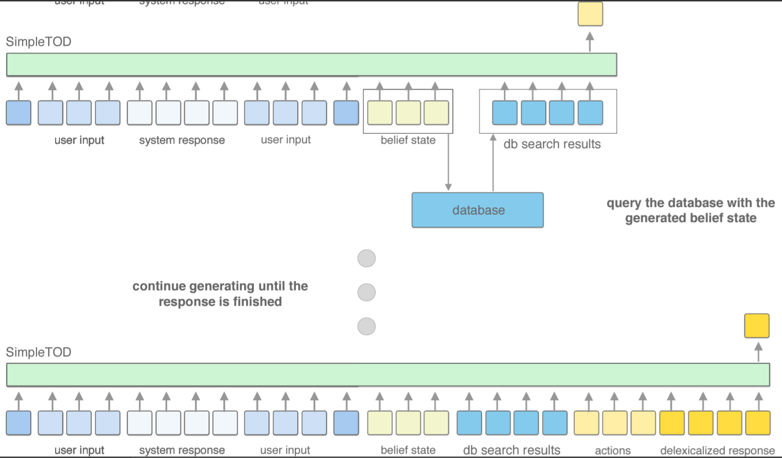
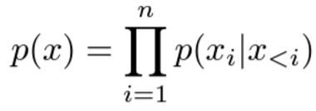
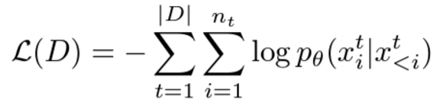
2. <SimpleTOD> Review
Causal Language Modeling
Notes:
Generate one token at a time
Add generated tokens to the input sequence for the next step of generation
Query the database with the generated belief state
Continue generating until the response is finished
Minimize negative log likelihood

Slide 17
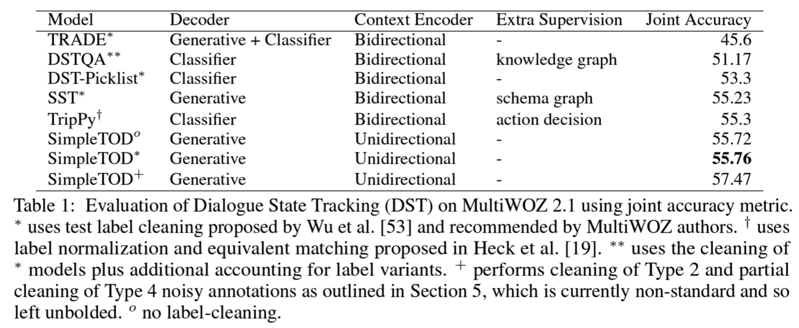
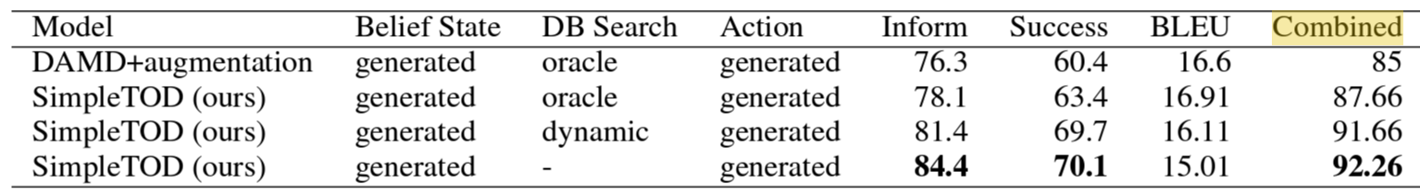
2. <SimpleTOD> Review
Evaluation
Notes:
performance of DST → Joint Goal Accuracy
Generated vs. Oracle belief states
Bt = (domain, slot_name, value) ← 해당 턴의 모든 triplet이 정답(oracle values)과 일치하여야 맞는 것으로 간주 (joint accuracy)
Action & Response Generation → inform rate, success rates, BLEU, Combined Score

Slide 18
2. <SimpleTOD> Review
Wrap-up
Previous Models
SimpleTOD
All previous models propose a bidirectional encoder
→ to learn better representation of context
beam search, diverse beam search, top-k sampling
= costly decoding strategy
test label cleaning
Causal Language Modeling (unidirectional)
= NOT bidirectional
Simple Greedy Decoding
= NOT costly
w/o any cleaning or normalization
= simply on the raw, original annotations

Slide 19
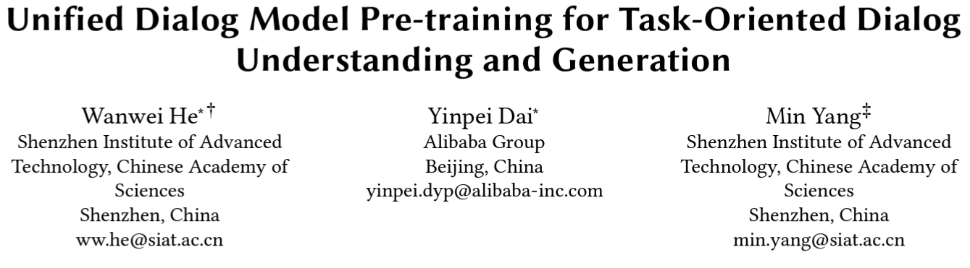
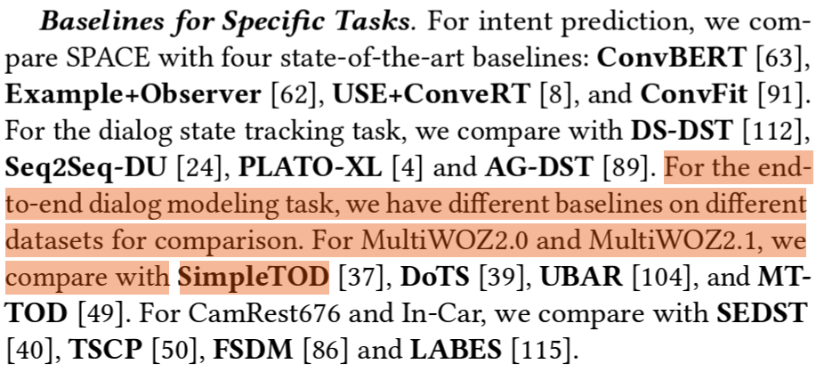
3. Recent Advancements
SPACE: Unified Pre-trained Conversation Model for TOD
Notes:
Unified PCM (Pre-trained Conversation Model)
TOD 시스템의 특징을 충분히 활용하고, dialog-related tasks를 연속적으로 연결함으로써 task-flow 를 유지하는데 성공한 첫 모델
Intent prediction, DST, end-to-end dialogue modeling 포함 8개의 downstream benchmark에서 SoTA 성능

Slide 20
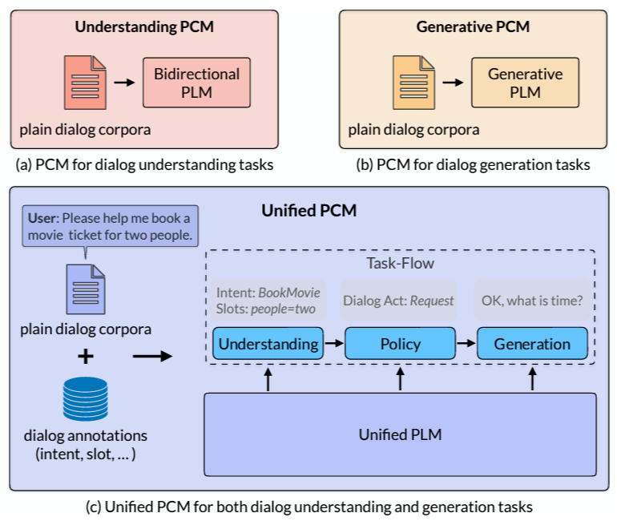
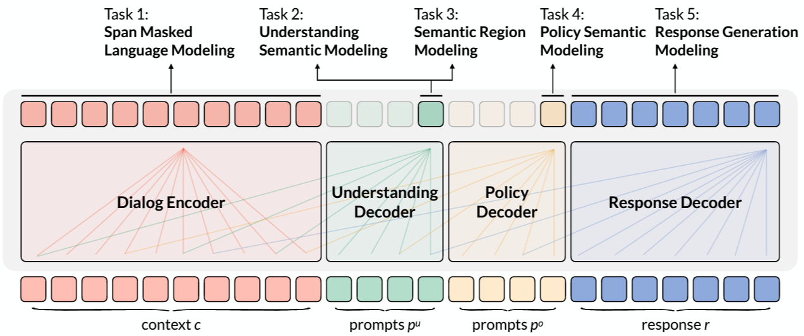
3. Recent Advancements
SPACE: Unified Dialog Model Pre-training for TOD
Notes:
1개의 encoder, 3개의 decoder 총 4개의 모듈로 구성됨 (다른 색상: self-attention position)
Encoder: Bi-directional
Decoders: unidirectional
외부의 input (Understanding Decoder, Policy Decoder): 2개의 prompt → semantic 추출에 사용됨
최종적으로 5개의 Task에 대한 pre-training objectives 결합 → SPACE 모델 최적화

Slide 21
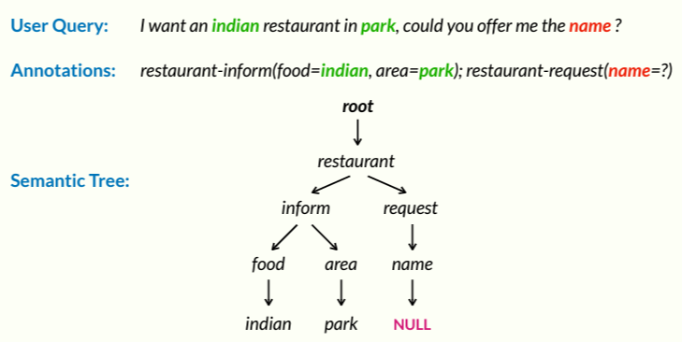
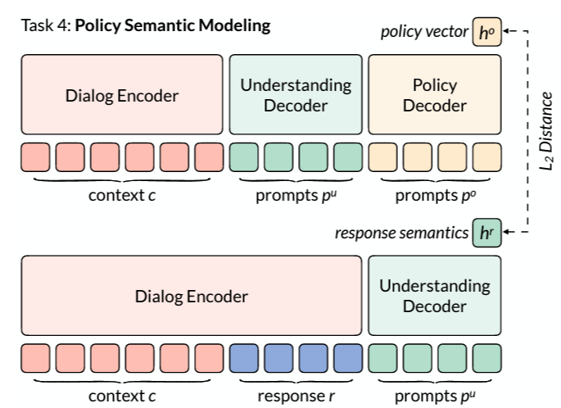
3. Recent Advancements
SPACE: Unified Pre-trained Conversation Model for TOD
Notes:
In Policy Semantic Modeling → h0 & hr의 L2 distance 최소화
Ho: output으로 예측된 policy vector
Hr: policy 최적화를 위해 추출된 response semantic vector
Tree-induced semi-supervised contrastive learning objective
목적: dialog representation learning on large-scale dialog corpora 성능 증가
방법: Dialog Understanding module 을 tree-induced semi-supervised contrastive learning objective에 pre-training
Tree에 저장된 semantic annotation ➔ dialog sample의 유사도 스코어 계산
Labeled data & unlabeled data 에 모두 pre-training
Labeled Dataset: domain, intent, slot, value labels ➔ semi-supervised objective
기존 방법론: 정확히 일치하면 positive, 이외의 것들은 모두 negative
All –in batch data들을 모두 positive 로 간주 후, 0~1 범위 내의 유사도 스코어를 다르게 부여
unlabeled dataset에 pre-training ➔ self-supervised contrastive objective

Slide 22
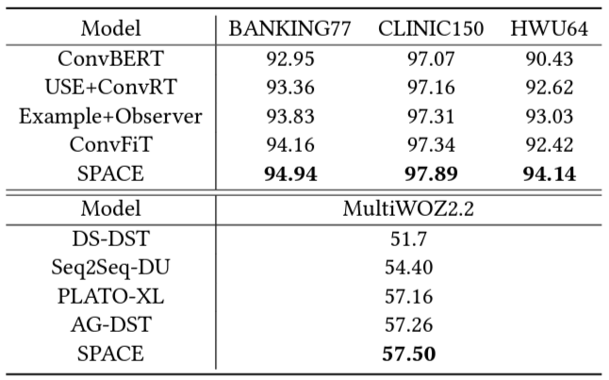
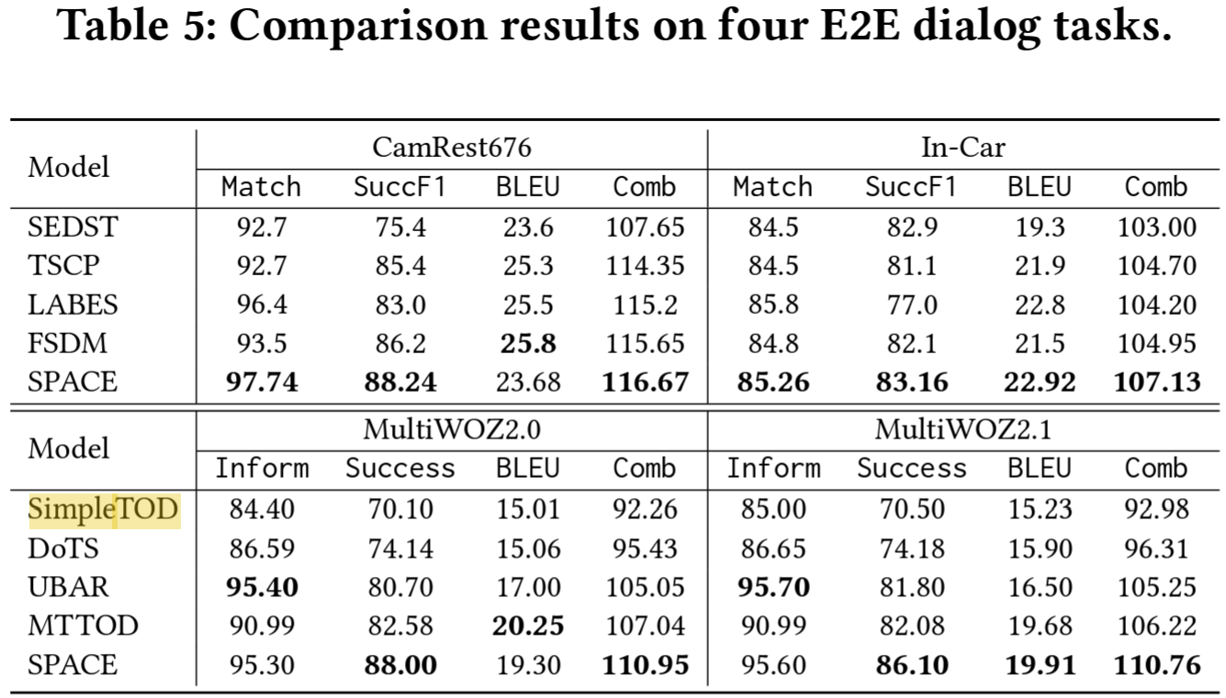
3. Recent Advancements
SPACE: Unified Dialog Model Pre-training for TOD

Slide 23
References
1. TOD
Zhang, Zheng, et al. "Recent advances and challenges in task-oriented dialog systems." Science China Technological Sciences 63.10 (2020): 2011-2027.
Zhang, Yichi, Zhijian Ou, and Zhou Yu. "Task-oriented dialog systems that consider multiple appropriate responses under the same context." Proceedings of the AAAI Conference on Artificial Intelligence. Vol. 34. No. 05. 2020.
Peng, Baolin, et al. "Soloist: Few-shot task-oriented dialog with a single pretrained auto-regressive model." arXiv preprint arXiv:2005.05298 3 (2020).
2. SimpleTOD Review
Hosseini-Asl, Ehsan, et al. "A simple language model for task-oriented dialogue." Advances in Neural Information Processing Systems 33 (2020): 20179-20191.
Budzianowski, Paweł, et al. "Multiwoz--a large-scale multi-domain wizard-of-oz dataset for task-oriented dialogue modelling." arXiv preprint arXiv:1810.00278 (2018).
3. Recent Advancements
He, Wanwei, et al. "Unified dialog model pre-training for task-oriented dialog understanding and generation." Proceedings of the 45th International ACM SIGIR Conference on Research and Development in Information Retrieval. 2022.

Slide 24
THANK YOU

